Slide 1
Chapter 5
The Relational Data Model and
Relational Database Constraints

Slide 2
- Relational Model Concepts
- Relational Model Constraints and Relational Database Schemas
- Update Operations, Transactions, and Dealing with Constraint Violations
Content

Slide 3
Relational Model Concepts
Relational model: represents the database as a collection of relations. Each relation resembles a table of values or a flat file of records.
It is called a flat file because each record has a simple linear or flat structure.
Important terminology:
Terms | Description
Tuple | A row
Attribute | A column header
Relation | Table
Domain of possible values | Data type describing the types of values that can appear in each column

Slide 4
Relational Model Concepts
Domains, Attributes, Tuples, and Relations
Domains
A domain “D” defines allowable values, including its data type, length, values.
To specify a domain - specify a data type from which the data values forming the domain are drawn (valid values which a data element may contain).
Examples of domains:
  Names: The set of character strings that represent names of persons. (For example : 0 to 30)
  Grade_point_averages: Possible values of computed grade point averages; each must be a real (floating-point) number between 0 and 4.
  Employee_ages: Possible ages of employees in a company, each must be an integer value between 15 and 80.
  Academic_department_names. The set of academic department names in a university, such as Computer Science, Economics, and Physics.

Slide 5
Relational Model Concepts
Domains, Attributes, Tuples, and Relations
Attributes
A relation schema “R”, denoted by R(A1, A2, … , An), is made up of a relation name “R” and a list of attributes, A1, A2, … , An.
“D” is called the domain of Ai and is denoted by dom(Ai). [dom(Name)]
A relation schema is used to describe a relation;
  “R” is called the name of this relation.
The degree (or arity) of a relation is the number of attributes n of its relation schema.
A relation of degree seven, which stores information about university students, would contain seven attributes describing each student as follows:
  STUDENT(Name, Ssn, Home_phone, Address, Office_phone, Age, Gpa)
Using the data type of each attribute, the definition is sometimes written as:
  STUDENT(Name: string, Ssn: string, Home_phone: string, Address: string, Office_phone: string, Age: integer, Gpa: real)

Slide 6
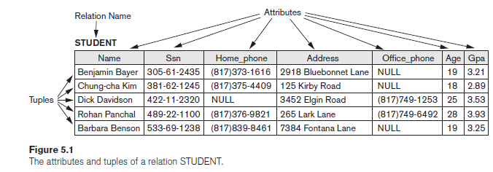
Relational Model Concepts
Domains, Attributes, Tuples, and Relations
Tuples and Relations
A relation (or relation state) r of the relation schema R(A1, A2, … , An), also denoted by r(R), is a set of n-tuples r = {t1, t2, … , tm}.
  Tuples currently in the database
Each n-tuple t is an ordered list of n values t =<v1, v2, … , vn>, where each value vi, 1 ≤ i ≤ n, is an element of dom (Ai) or is a special NULL value.
Figure shows an example of a STUDENT relation, which corresponds to the STUDENT schema specified.
Each tuple in the relation represents a particular student entity (or object).

Slide 7
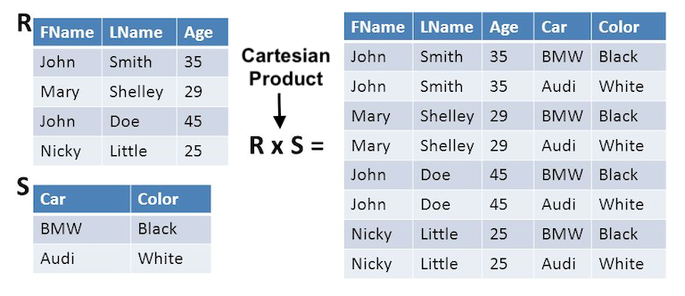
Relational Model Concepts
Domains, Attributes, Tuples, and Relations
Tuples and Relations
Definition of a relation can be restated using set theory concepts.
“A relation (or relation state) r(R) is a mathematical relation of degree n on the domains dom(A1), dom(A2), … , dom(An), which is a subset of the Cartesian product (denoted by ×) of the domains that define R:
  r(R) ⊆ (dom(A1) × dom(A2) × . . . × (dom(An))
If we denote the total number of values, or cardinality, in a domain D by |D| (assuming that all domains are finite), the total number of tuples in the Cartesian product is |dom(A1)| × |dom(A2)| × . . . × |dom(An)|
A relation state at a given time contains only the valid tuples that represent a particular state.

Slide 8
Relational Model Concepts
Domains, Attributes, Tuples, and Relations
Tuples and Relations
Let R(A1, A2) be a relation schema:
Let dom(A1) = {0,1}
Let dom(A2) = {a,b,c}
Then: dom(A1) X dom(A2) is all possible combinations:
{<0,a> , <0,b> , <0,c>, <1,a>, <1,b>, <1,c> }
The relation state r(R)  dom(A1) X dom(A2)
For example: r(R) could be {<0,a> , <0,b> , <1,c> }
This is one possible state (or “population” or “extension”) r of the relation R, defined over A1 and A2.
It has three 2-tuples: <0,a> , <0,b> , <1,c>

Slide 9
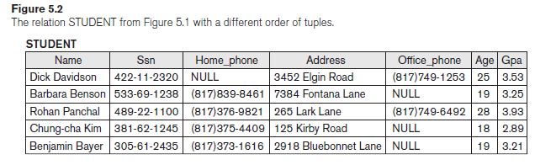
Relational Model Concepts
Characteristics of Relations
Ordering of Tuples in a Relation
Relation - a set of tuples
Elements of a set have no order among them; hence, tuples in a relation do not have any particular order.
In a file, records are physically stored on disk (or in memory), so there always is an order among the records. This ordering indicates first, second, ith, and last records in the file. Similarly, when we display a relation as a table, the rows are displayed in a certain order.
For example, tuples in the STUDENT relation in Figure 5.1 could be ordered by values of Name, Ssn, Age, or some other attribute. The definition of a relation does not specify any order: There is no preference for one ordering over another.
Hence, the relation displayed in Figure 5.2 is considered identical to the one shown in Figure 5.1.

Slide 10
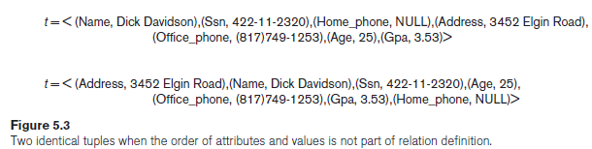
Relational Model Concepts
Characteristics of Relations
Ordering of Values within a Tuple
A tuple can be considered as a set of (<attribute>, <value>) pairs, where each pair gives the value of the mapping from an attribute Ai to a value vi from dom(Ai).
The ordering of attributes is not important, because the attribute name appears with its value.
This makes sense at an abstract level, since there really is no reason to prefer having one attribute value appear before another in a tuple.

Slide 11
Relational Model Concepts
Characteristics of Relations
Values and NULLs in the Tuples.
An important concept is that of NULL values, which are used to represent the values of attributes that may be unknown or may not apply to a tuple. A special value, called NULL, is used in these cases.
Some STUDENT tuples have NULL for their office phones because they do not have an office.
Another student has a NULL for home phone, presumably because either he does not have a home phone or he has one but we do not know it (value is unknown).
In general, we can have several meanings for NULL values, such as value unknown, value exists but is not available, or attribute does not apply to this tuple (also known as value undefined).

Slide 12
Relational Model Concepts
Characteristics of Relations
Interpretation (Meaning) of a Relation
The relation schema can be interpreted as a declaration or a type of assertion.
For example, the schema of the STUDENT relation of Figure 5.1 asserts that, in general, a student entity has a Name, Ssn, Home_phone, Address, Office_phone, Age, and Gpa.
Each tuple in the relation can then be interpreted as a fact or a particular instance of the assertion.
  For example, the first tuple in Figure 5.1 asserts the fact that there is a STUDENT whose Name is Benjamin Bayer, Ssn is 305-61-2435, Age is 19, and so on.

Slide 13
Relational Model Concepts
Relational Model Notation
A relation schema R of degree n is denoted by R(A1, A2, … , An).
The uppercase letters Q, R, S denote relation names.
The lowercase letters q, r, s denote relation states.
The letters t, u, v denote tuples.
In general, the name of a relation such as STUDENT also indicates the current set of tuples in that relation—the current relation state—whereas STUDENT(Name, Ssn, …) refers only to the relation schema.
An n-tuple t in a relation r(R) is denoted by t = <v1, v2, … , vn>, where vi is the value corresponding to attribute Ai. The following notation refers to component values of tuples:
Both t[Ai] and t.Ai (and sometimes t[i]) refer to the value vi in t for attribute Ai.
As an example, consider the tuple t = <’Barbara Benson’, ‘533-69-1238’, ‘(817)839-8461’, ‘7384 Fontana Lane’, NULL, 19, 3.25> from the STUDENT relation in Figure 5.1; we have t[Name] = <‘Barbara Benson’>, and t[Ssn, Gpa, Age] = <‘533-69-1238’, 3.25, 19>.

Slide 14
Relational Model Constraints and Relational Database Schemas
Constraints on databases can generally be divided into three main categories:
1. Constraints that are inherent in the data model. We call these inherent model-based constraints or implicit constraints.
2. Constraints that can be directly expressed in the schemas of the data model, typically by specifying them in the DDL .We call these schema-based constraints or explicit constraints. (e.g., films have only one director)
3.Constraints that cannot be directly expressed in the schemas of the data model, and hence must be expressed and enforced by the application programs or in some other way. We call these application-based or semantic constraints or business rules. (e.g., this year’s salary increase can be no more than last year’s)

Slide 15
Relational Model Constraints and Relational Database Schemas
Domain Constraints
Domain constraints specify that within each tuple, the value of each attribute A must be an atomic value from the domain dom(A).
The data types associated with domains typically include:
  standard numeric data types for integers (such as short integer, integer and long integer)
  real numbers (float and double-precision float)
Characters, Booleans, fixed-length strings, and variable-length strings are also available, as are date, time, timestamp, and other special data types.

Slide 16
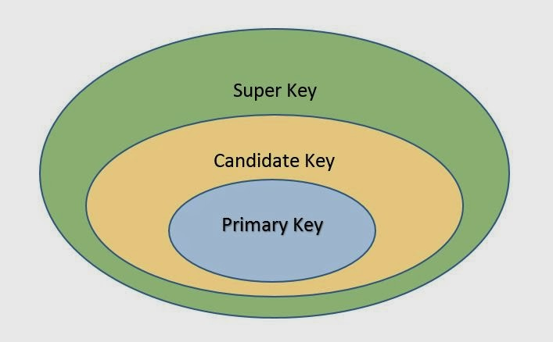
Relational Model Constraints and Relational Database Schemas
Key Constraints and Constraints on NULL Values

Slide 17
Relational Model Constraints and Relational Database Schemas
Key Constraints and Constraints on NULL Values
A superkey SK specifies a uniqueness constraint that no two distinct tuples in any state r of R can have the same value for SK.
Every relation has at least one default superkey— the set of all its attributes.
Suppose that we denote one such subset of attributes by SK; then for any two distinct tuples t1 and t2 in a relation state r of R, we have the constraint that: t1[SK] ≠ t2[SK]

Slide 18
Relational Model Constraints and Relational Database Schemas
Key Constraints and Constraints on NULL Values
A superkey can have redundant attributes, however, so a more useful concept is that of a key, which has no redundancy.
Hence, a key satisfies two properties:
  1. Two distinct tuples in any state of the relation cannot have identical values for (all) the attributes in the key. This uniqueness property also applies to a superkey.
  2. It is a minimal superkey—that is, a superkey from which we cannot remove any attributes and still have the uniqueness constraint hold. This minimality property is required for a key but is optional for a superkey.

Slide 19
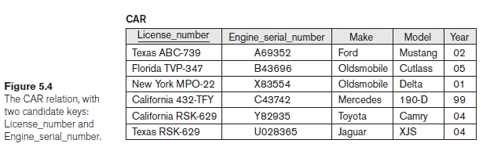
Relational Model Constraints and Relational Database Schemas
Key Constraints and Constraints on NULL Values
A key is a superkey but not vice versa.
Consider the STUDENT relation. The attribute set {Ssn} is a key of STUDENT because no two student tuples can have the same value for Ssn. Any set of attributes that includes Ssn—for example, {Ssn, Name, Age}—is a superkey.
In general, a relation schema may have more than one key. In this case, each of the keys is called a candidate key. For example, the CAR relation in Figure 5.4 has two candidate keys: License_number and Engine_serial_number.
It is common to designate one of the candidate keys as the primary key of the relation. This is the candidate key whose values are used to identify tuples in the relation.

Slide 20
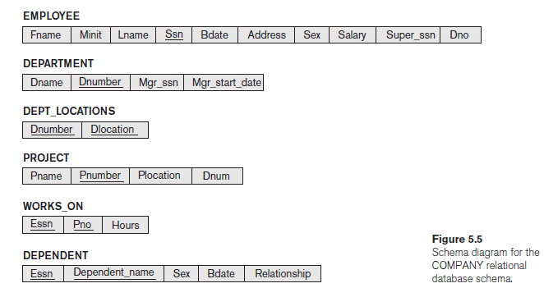
Relational Model Constraints and Relational Database Schemas
Relational Databases and Relational Database Schemas
A relational database schema S is a set of relation schemas S = {R1, R2, … , Rm} and a set of integrity constraints.
Figure 5.5 shows a relational database schema that we call COMPANY = {EMPLOYEE, DEPARTMENT, DEPT_LOCATIONS, PROJECT, WORKS_ON, DEPENDENT}. In each relation schema, the underlined attribute represents the primary key.

Slide 21
Relational Model Constraints and Relational Database Schemas
Relational Databases and Relational Database Schemas
A relational database state DB of S is a set of relation states DB = {r1, r2, ..., rm} such that each ri is a state of Ri and such that the ri relation states satisfy the integrity constraints specified in IC.
A relational database state is sometimes called a relational database snapshot or instance.
A database state that does not meet the constraints is an invalid state.
Each relation will have many tuples in its current relation state
The relational database state is a union of all the individual relation states

Slide 22
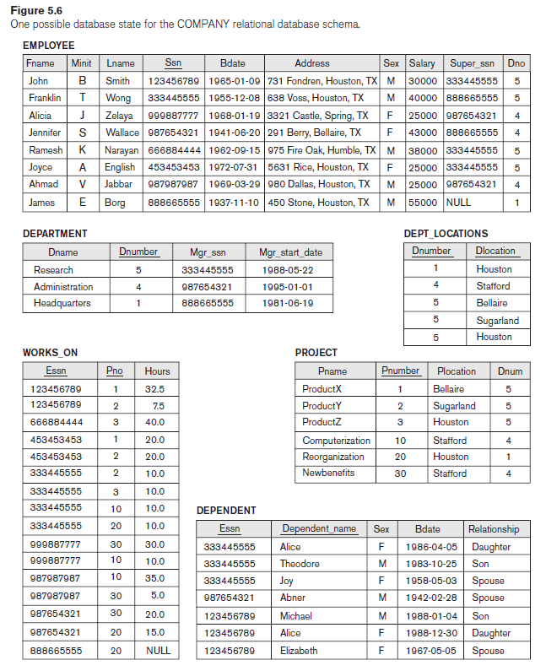
Relational Model Constraints and Relational Database Schemas

Slide 23
Relational Model Constraints and Relational Database Schemas
Entity Integrity, Referential Integrity, and Foreign Keys
Entity integrity constraint
The entity integrity constraint states that no primary key value can be NULL. This is because the primary key value is used to identify individual tuples in a relation.
Having NULL values for the primary key implies that we cannot identify some tuples.
  For example, if two or more tuples had NULL for their primary keys, we may not be able to distinguish them if we try to reference them from other relations.

Slide 24
Relational Model Constraints and Relational Database Schemas
Entity Integrity, Referential Integrity, and Foreign Keys
Referential integrity constraint
Key constraints and entity integrity constraints are specified on individual relations.
The referential integrity constraint is specified between two relations and is used to maintain the consistency among tuples in the two relations.
Referential integrity constraint states that a tuple in one relation that refers to another relation must refer to an existing tuple in that relation.
  For example, in Figure 5.6, the attribute Dno of EMPLOYEE gives the department number for which each employee works; hence, its value in every EMPLOYEE tuple must match the Dnumber value of some tuple in the DEPARTMENT relation.

Slide 25
Relational Model Constraints and Relational Database Schemas
Entity Integrity, Referential Integrity, and Foreign Keys
Referential integrity constraint
A set of attributes FK in relation schema R1 is a foreign key of R1 that references relation R2 if it satisfies the following rules:
1. The attributes in FK have the same domain(s) as the primary key attributes PK of R2.
2. A value of FK in a tuple t1 of the current state r1(R1) either occurs as a value of PK for some tuple t2 in the current state r2(R2) or is NULL.
In the former case, we have t1[FK] = t2[PK], and we say that the tuple t1 refers to the tuple t2.
In this definition, R1 is called the referencing relation and R2 is the referenced relation.

Slide 26
Relational Model Constraints and Relational Database Schemas
Entity Integrity, Referential Integrity, and Foreign Keys
Referential integrity constraint
In the EMPLOYEE relation, the attribute Dno refers to the department for which an employee works; hence, we designate Dno to be a foreign key of EMPLOYEE referencing the DEPARTMENT relation.
This means that a value of Dno in any tuple t1 of the EMPLOYEE relation must match a value of the primary key of DEPARTMENT—the Dnumber attribute—in some tuple t2 of the DEPARTMENT relation,
or
the value of Dno can be NULL if the employee does not belong to a department or will be assigned to a department later.

Slide 27
Relational Model Constraints and Relational Database Schemas
Entity Integrity, Referential Integrity, and Foreign Keys
Referential integrity constraint
Notice that a foreign key can refer to its own relation.
  For example, the attribute Super_ssn in EMPLOYEE refers to the supervisor of an employee; this is another employee, represented by a tuple in the EMPLOYEE relation. Hence, Super_ssn is a foreign key that references the EMPLOYEE relation itself.
In Figure 5.6 the tuple for employee ‘John Smith’ references the tuple for employee ‘Franklin Wong,’ indicating that ‘Franklin Wong’ is the supervisor of ‘John Smith’.

Slide 28
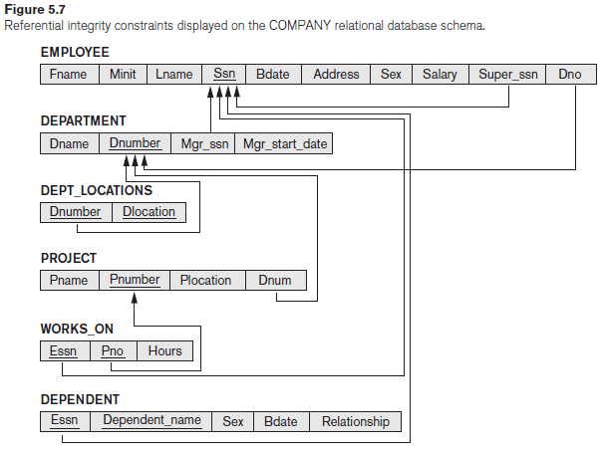
Relational Model Constraints and Relational Database Schemas
Entity Integrity, Referential Integrity, and Foreign Keys
Referential integrity constraint

Slide 29
Relational Model Constraints and Relational Database Schemas
Entity Integrity, Referential Integrity, and Foreign Keys
Other Types of Constraints
General constraints, sometimes called semantic integrity constraints, are not part of the DDL and have to be specified and enforced in a different way. Examples of such constraints are the salary of an employee should not exceed the salary of the employee’s supervisor and the maximum number of hours an employee can work on all projects per week is 56.
Mechanisms called triggers and assertions can be used in SQL, through the CREATE ASSERTION and CREATE TRIGGER statements, to specify some of these constraints.
The types of constraints we discussed so far may be called state constraints because they define the constraints that a valid state of the database must satisfy.
Another type of constraint, called transition constraints, can be defined to deal with state changes in the database. An example of a transition constraint is: “the salary of an employee can only increase.”

Slide 30
Update Operations, Transactions, and Dealing with Constraint Violations
There are three basic operations that can change the states of relations in the database:
Insert, Delete, and Update (or Modify).
  Insert is used to insert one or more new tuples in a relation
  Delete is used to delete tuples
  Update (or Modify) is used to change the values of some attributes in existing tuples.
Whenever these operations are applied, the integrity constraints specified on the relational database schema should not be violated.

Slide 31
Update Operations, Transactions, and Dealing with Constraint Violations
The Insert Operation
The Insert operation provides a list of attribute values for a new tuple t that is to be inserted into a relation R. Insert can violate any of the four types of constraints.
  Domain constraints can be violated if an attribute value is given that does not appear in the corresponding domain or is not of the appropriate data type.
  Key constraints can be violated if a key value in the new tuple t already exists in another tuple in the relation r(R).
  Entity integrity can be violated if any part of the primary key of the new tuple t is NULL.
  Referential integrity can be violated if the value of any foreign key in t refers to a tuple that does not exist in the referenced relation.

Slide 32
Update Operations, Transactions, and Dealing with Constraint Violations
The Insert Operation
Here are some examples to illustrate this discussion.
■ Operation:
Insert <‘Cecilia’, ‘F’, ‘Kolonsky’, NULL, ‘1960-04-05’, ‘6357 Windy Lane, Katy, TX’, F, 28000, NULL, 4> into EMPLOYEE.

Slide 33
Update Operations, Transactions, and Dealing with Constraint Violations
The Insert Operation
Here are some examples to illustrate this discussion.
■ Operation:
Insert <‘Alicia’, ‘J’, ‘Zelaya’, ‘999887777’, ‘1960-04-05’, ‘6357 Windy Lane, Katy, TX’, F, 28000, ‘987654321’, 4> into EMPLOYEE.

Slide 34
Update Operations, Transactions, and Dealing with Constraint Violations
The Insert Operation
Here are some examples to illustrate this discussion.
■ Operation:
Insert <‘Cecilia’, ‘F’, ‘Kolonsky’, ‘677678989’, ‘1960-04-05’, ‘6357 Windswept, Katy, TX’, F, 28000, ‘987654321’, 7> into EMPLOYEE.

Slide 35
Update Operations, Transactions, and Dealing with Constraint Violations
The Insert Operation
Operation:
Insert <‘Cecilia’, ‘F’, ‘Kolonsky’, ‘677678989’, ‘1960-04-05’, ‘6357 Windy Lane, Katy, TX’, F, 28000, NULL, 4> into EMPLOYEE.
Reject: If an insertion violates one or more constraints, the default option is to reject the insertion.

Slide 36
Update Operations, Transactions, and Dealing with Constraint Violations
The Delete Operation
The Delete operation can violate only referential integrity. This occurs if the tuple being deleted is referenced by foreign keys from other tuples in the database.

Slide 37
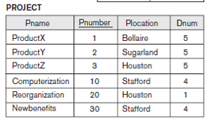
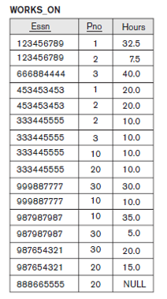
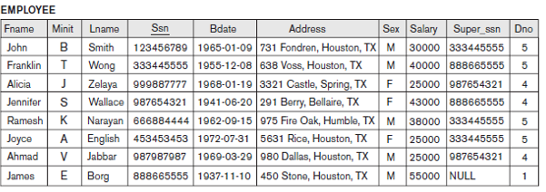
Update Operations, Transactions, and Dealing with Constraint Violations
The Delete Operation
Here are some examples.
■ Operation:
Delete the WORKS_ON tuple with Essn = ‘999887777’ and Pno = 10.

Slide 38
Update Operations, Transactions, and Dealing with Constraint Violations
The Delete Operation
■ Operation:
Delete the EMPLOYEE tuple with Ssn = ‘999887777’.

Slide 39
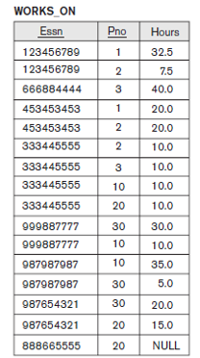
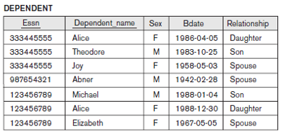
Update Operations, Transactions, and Dealing with Constraint Violations
The Delete Operation
■ Operation:
Delete the EMPLOYEE tuple with Ssn = ‘333445555’.

Slide 40
Update Operations, Transactions, and Dealing with Constraint Violations
The Delete Operation
Several options are available if a deletion operation causes a violation.
Restrict: to reject the deletion(DEFAULT).
Cascade: attempt to cascade (or propagate) the deletion by deleting tuples that reference the tuple that is being deleted. For example, in operation 2, the DBMS could automatically delete the offending tuples from WORKS_ON with Essn = ‘999887777’.
Set null or set default: modify the referencing attribute values that cause the violation; each such value is either set to NULL or changed to reference another default valid tuple(to be done on Foreign Keys).

Slide 41
Update Operations, Transactions, and Dealing with Constraint Violations
The Update Operation
Updating an attribute that is neither part of a primary key nor part of a foreign key usually causes no problems; the DBMS need only check to confirm that the new value is of the correct data type and domain.
Modifying a primary key value is similar to deleting one tuple and inserting another in its place because we use the primary key to identify tuples.
If a foreign key attribute is modified, the DBMS must make sure that the new value refers to an existing tuple in the referenced relation (or is set to NULL).
Similar options exist to deal with referential integrity violations caused by Update as those options discussed for the Delete operation. (Cascade, Set null, set default).

Slide 42
Update Operations, Transactions, and Dealing with Constraint Violations
The Update Operation
The Update (or Modify) operation is used to change the values of one or more attributes in a tuple (or tuples) of some relation R. Here are some examples.
■ Operation:
Update the salary of the EMPLOYEE tuple with Ssn = ‘999887777’ to 28000.
■ Operation:
Update the Dno of the EMPLOYEE tuple with Ssn = ‘999887777’ to 1.

Slide 43
Update Operations, Transactions, and Dealing with Constraint Violations
The Update Operation
■ Operation:
Update the Dno of the EMPLOYEE tuple with Ssn = ‘999887777’ to 7.

Slide 44
Update Operations, Transactions, and Dealing with Constraint Violations
The Update Operation
■ Operation:
Update the Ssn of the EMPLOYEE tuple with Ssn = ‘999887777’ to ‘987654321’.

Slide 45
Update Operations, Transactions, and Dealing with Constraint Violations
The Transaction Concept
A transaction is an executing program that includes some database operations, such as reading from the database, or applying insertions, deletions, or updates to the database. At the end of the transaction, it must leave the database in a valid or consistent state that satisfies all the constraints specified on the database schema.
A single transaction may involve any number of retrieval operations and any number of update operations.
For example, a transaction to apply a bank withdrawal will typically read the user account record, check if there is a sufficient balance, and then update the record by the withdrawal amount.
A large number of commercial applications running against relational databases in online transaction processing (OLTP) systems are executing transactions at rates that reach several hundred per second.

